Slide 1
Exploring Options for Municipal Water in Jenkinsville
and Nearby Eastern Areas of the Town of Queensbury
Public Informational Meeting | April 17, 2023

Slide 2
The Queensbury Town Board is exploring potential municipal water supply options for the eastern area of the Town.
— We are in the exploratory phase. No decisions or commitments have been made.
— The Town Board wants to hear feedback from the community.
— We are seeking options that are affordable and attractive to the majority of
property owners.

Slide 3
The Town Board engaged engineering firm C.T. Male Associates to assess potential options. C.T. Male identified two conceptual approaches.
— The community was asked to provide feedback in August 2022.
— Based on community input and further engineering and financial analysis, C.T. Male has now developed substantial additional information about the options.

Slide 4
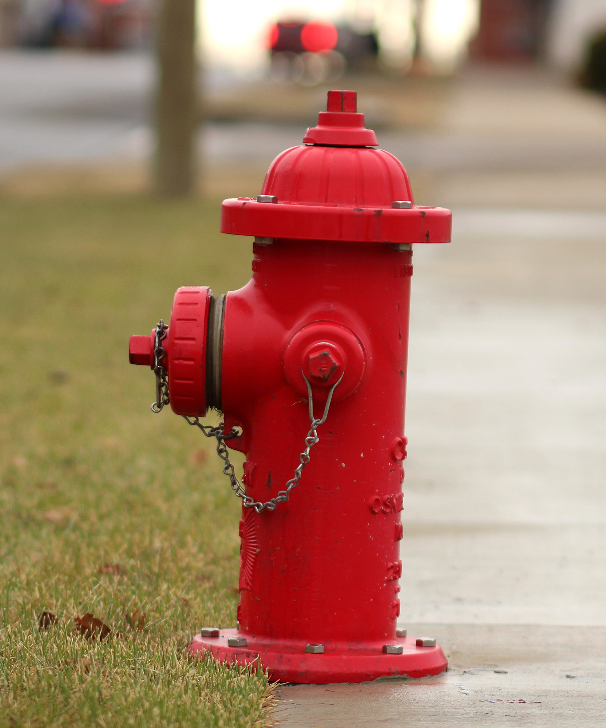
Both Options Would:
— Bring public water to the Jenkinsville area and to other
nearby eastern Queensbury neighborhoods that do not
have public water service now.
— Provide additional fire protection to the entire area through the installation of hydrants in areas without hydrants now.
Both options contemplate inclusion of the proposed
Eastern Queensbury service area into the existing
Queensbury Consolidated Water District.

Slide 5
What Would This Cost Property Owners?
C.T. Male has developed projections:
— Based on Townwide average residential property assessment of $300,000.
— Based on average residential water use estimate of 80,000 gallons.
— Contemplating that the Eastern Queensbury District becomes part of the consolidated Queensbury Water District.
— But without state or federal aid.
— If State or Federal aid were received, it could reduce costs to property owners

Slide 6
Option 1: Ridge-Stonehurst-East Sunnyside-Jenkinsville Route
Number of parcels served: 176 new, 9,104 total
Total projected cost: $5,935,290
For property owners who accept town water, range of estimated annual cost per parcel over 30 years: $400 - $575, including average water usage
For property owners who do not accept town water, range of estimated annual cost per parcel: $145 to $320, based on assessed value.
Projected cost increase for property owners in Queensbury Consolidated Water District: $40 - $50 per year
Estimates do not reflect State or Federal funding, which, if received, could reduce costs.

Slide 7
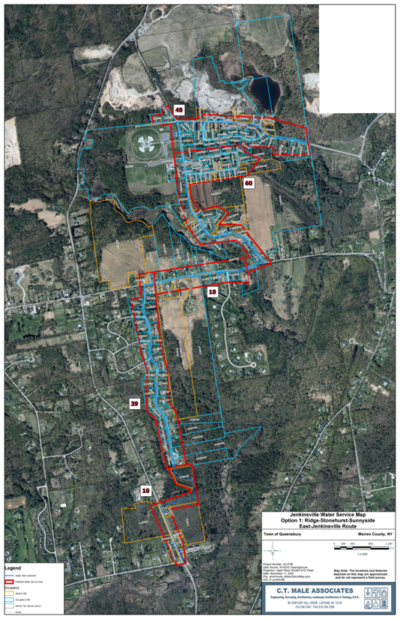
Option 1:
Ridge-Stonehurst-East Sunnyside-Jenkinsville Route

Slide 8
Option 2: Ridge-Sunnyside-Town Park-Jenkinsville Route
Number of parcels served: 187 new, 9115 total
Total projected cost: $6,480,460
For property owners who accept town water, range of estimated annual cost per parcel over 30 years: $400 - $575, including average water usage.
For property owners who do not accept town water, range of estimated annual cost per parcel: $145 to $320, based on assessed value.
Projected cost increase for property owners in Queensbury Consolidated Water District: $40 - $50 per year
Estimates do not reflect State or Federal funding, which, if received, could reduce costs.

Slide 9
Option 2:
Ridge-Sunnyside-Town Park-
Jenkinsville Route

Slide 10
The Assumptions:
State Grants: The estimates presented here do not include State or Federal aid which, if received, could further reduce the cost to property owners. With C.T. Male’s assistance, the Town is exploring grant opportunities. While we believe the proposed project would meet the criteria for some funding programs, there is no guarantee grants will be obtained.
Municipal bonding: The project would be financed with municipal bonds over a 30-year period at an estimated average interest rate of 4.5%.
Associated Fees: Engineering fees are estimated at 15 percent; bonding costs, 4.5 percent, legal fees, 2 percent. An overall contingency of 15 percent is built into the estimate.

Slide 11
Why Consolidate with Existing District?
Over the long term, consolidating the two town water districts would result in savings on engineering, construction, maintenance and operating costs.
Consolidation would allow for potential future expansion into the Lake Sunnyside, Glen Lake and other areas of the town unserved by public water, if there is a need and community support.

Slide 12
Benefits to Property Owners
Property owners in the proposed Eastern Queensbury Water District would not be required to accept town water, except in the Jenkinsville area or where there is evidence of contamination.
Even if they do not wish to accept public water at this time, the installation of public water lines provides property owners with two major benefits:
-- The option to hook up to public water in the future, if they or future owners wish to do so.
-- Improved fire protection through the installation of fire hydrants in their neighborhood.
The Town is exploring the possibility of assisting property owners with the cost of connecting to the public water for a defined period of time.
For property owners who do not accept public water, the cost would be $145 to $320 per year, based on assessments. State or Federal grants could further reduce that cost.

Slide 13
Next Steps:
After receiving community input, the Town Board will refine the options and consider choosing an optimal route.
A Map, Plan and Report on the proposed water district will be prepared and a public hearing held.
The Town Board will consider whether to authorize creation of the district and whether to amend boundaries of the existing Queensbury Consolidated Water District to include the Eastern Queensbury District.
If those steps are authorized, the Town Board would engage engineers to develop construction plans and continue efforts to obtain state or federal funding.
Design and construction is expected to take at least 2-3 years.

